Slide 1
Scan Conversion Of Circle
Course Title: Computer Graphics
Course Code: CSE - 413

Slide 2
Outlines:-
Bresenham circle drawing algorithm
Mid-point circle drawing algorithm

Slide 3
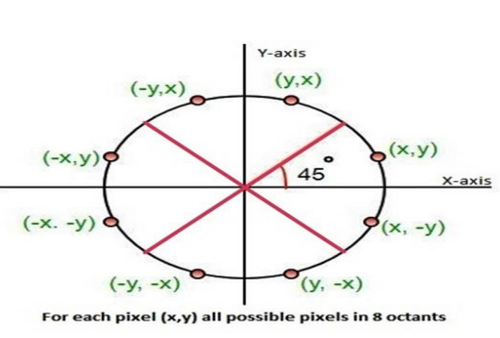
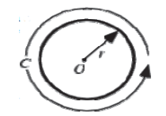
Circle A circle is the set of points in a plane that are equidistant from a given point O. The distance r from the center is called the radius, and the point O is called the center. Twice the radius is known as the diameter d=2r. The angle a circle subtends from its center is a full angle, equal to 360° or 2π radians.
A circle has the maximum possible area for a given perimeter, and the minimum possible perimeter for a given area. The perimeter C of a circle is called the circumference, and is given by C = 2 π r.
It is an eight-way symmetric figure which can be divided into four quadrants and each quadrant has two octants. This symmetry helps in drawing a circle on a computer by knowing only one point of any octant.

Slide 4
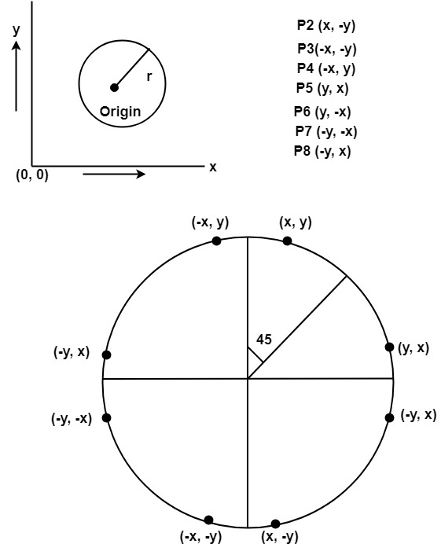
For drawing, circle considers it at the origin. If a point is P₁(x, y), then the other seven points will be
So we will calculate only 45°arc. From which the whole circle can be determined easily.
If we want to display circle on screen then the putpixel function is used for eight points as shown below:
putpixel (x, y, color)
putpixel (x, -y, color)
putpixel (-x, y, color)
putpixel (-x, -y, color)
putpixel (y, x, color)
putpixel (y, -x, color)
putpixel (-y, x, color)
putpixel (-y, -x, color)

Slide 5
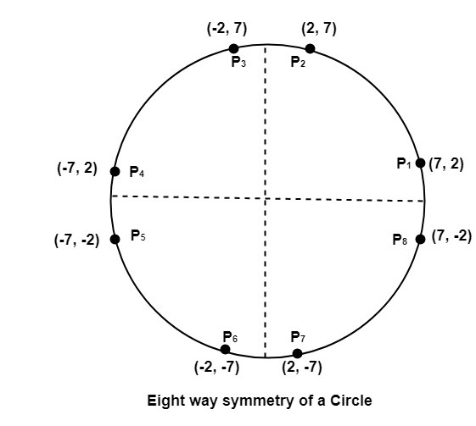
Example: Let we determine a point (2, 7) of the circle then other points will be (2, -7), (-2, -7), (-2, 7), (7, 2), (-7, 2), (-7, -2), (7, -2)
These seven points are calculated by using the property of reflection. The reflection is accomplished in the following way:
The reflection is accomplished by reversing x, y co-ordinates.

Slide 6
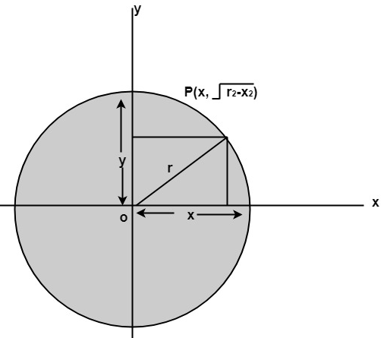
There are two standards methods of mathematically defining a circle centered at the origin.
Defining a circle using Polynomial Method
Defining a circle using Polar Co-ordinates
Direct or Polynomial Method
This technique uses the equation for a circle on radius r centered at (0, 0) given as:
x 2+ y2 = r2 ,
an obvious choice is to plot
y = ± √(r2-x2)
Obviously in most of the cases the circle is not centered at (0, 0), rather there is a center point (h, k); other than (0, 0). Therefore, the equation of the circle having center at point (h, k):
(x - h) 2 + (y - k) 2 = r2
For each value of x, value of y can be calculated using,
y = k ± √r2 – (x - h) 2
The initial points will be: x = h – r, and y = k
This is a very ineffective method because for each point value of h, x and r are squared and then subtracted and then the square root is calculated, which leads to high time complexity. It also creates large gaps in the circle for values of x close to r as shown in the following figure.

Slide 7
Algorithm:
Step1: Set the initial variables
r = circle radius
(h, k) = coordinates of circle center
x=o
I = step size
x_{end}= r / √2
Step2: Test to determine whether the entire circle has been scan-converted.
If x > x_{end} then stop.
Step3: Compute y = ± √(r2-x2)
Step4: Plot the eight points found by symmetry concerning the center (h, k) at the current (x, y) coordinates.
Plot (x + h, y +k) Plot (-x + h, -y + k)
Plot (y + h, x + k) Plot (-y + h, -x + k)
Plot (-y + h, x + k) Plot (y + h, -x + k)
Plot (-x + h, y + k) Plot (x + h, -y + k)
Step5: Increment x = x + i
Step6: Go to step (ii).

Slide 8
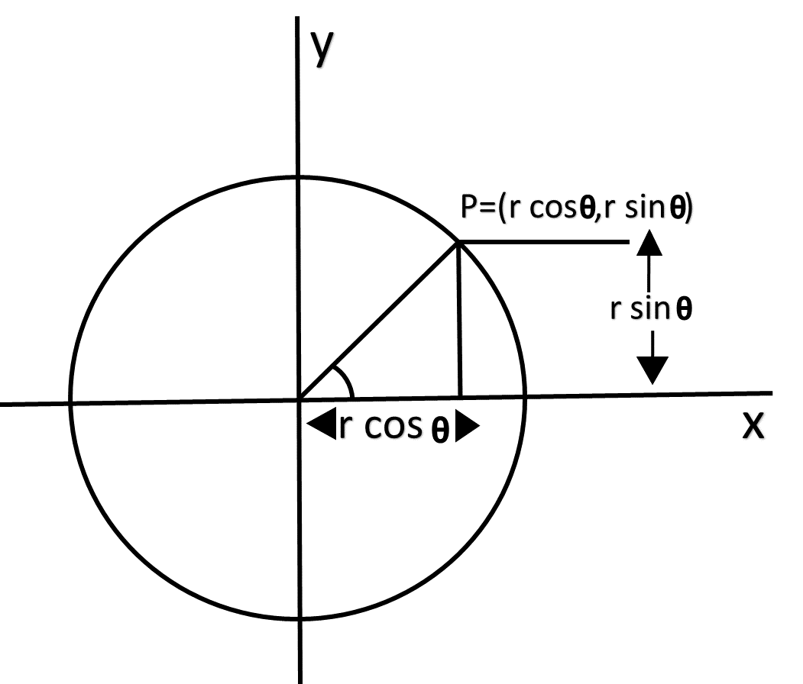
2. Polar coordinates Method A better approach, to eliminate unequal spacing as shown in above figure is to calculate points along the circular boundary using polar coordinates r and θ.
Expressing the circle equation in parametric polar form yields the pair of equations
x = r cosθ ...(1)
y = r sinθ ...(2)
X2+y2 = r2
Using above equation circle can be plotted by calculating x and y coordinates as θ takes values from 0 to 360 degrees or 0 to 2π. The step size chosen for θ depends on the application and the display device. Larger angular separations along the circumference can be connected with straight-line segments to approximate the circular path. For a more continuous boundary on a raster display, we can set the step size at 1/r. This plots pixel positions that are approximately one unit apart.

Slide 9
Now let us see how this technique can be sum up in algorithmic form.
Circle (h, k, radius)
for θ = 0 to 2π; step 1/r
x = h + r * cosθ
y = k + r * sinθ
drawPixel (x, y)
Again, this is very simple technique and also solves problem of unequal space but unfortunately this technique is still inefficient in terms of calculations involves especially floating-point calculations.
Calculations can be reduced by considering the symmetry of circles.
We know that the shape of circle is similar in each quadrant. For the first octant i.e., from θ = 0⁰ to θ = 45⁰
The values of x and y are calculated using equations (1) and (2).
Simultaneously, all the eight points for the rest of the octants can be calculated using the eightway symmetry property of the circle. Then, the plotting of the circle is done.
Hence, we have reduced half the calculations by considering symmetric octants of the circle but as we discussed earlier inefficiency is still there and that is due to the use of floating-point calculations. In next algorithm we will try to remove this problem.

Slide 10
Algorithm for Polar coordinates Method
Step1: Set the initial variables:
r = circle radius
(h, k) = coordinates of the circle center
Step2: for θ = 0 to π / 4; step 1/r
Compute x = h + r * cos θ
y = k + r * sin θ
DrawSymmetricPoints (h, k, x, y)
Step3: DrawSymmetricPoints (h, k, x, y)
(i.e., the center (h, k), at the current (x, y) coordinates)
Plot (x + h, y + k) Plot (-x + h, -y + k)
Plot (y + h, x + k) Plot (-y + h, -x + k)
Plot (-y + h, x + k) Plot (y + h, -x + k)
Plot (-x + h, y + k) Plot (x + h, -y + k)
Step4: Go to step2.
Step5: Stop

Slide 11
There are two circle drawing algorithms: 1. Bresenham Circle Drawing Algorithm 2. Mid-Point Circle Drawing Algorithm

Slide 12
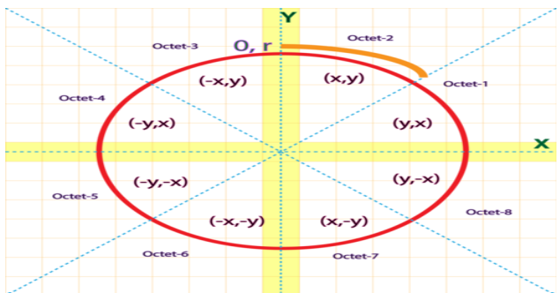
Bresenham Circle Drawing Algorithm
The Bresenham's circle drawing algorithm is a circle drawing algorithm which calculates all the nearest points nearest to the circle boundary. It is an incremental method (i.e., we increment one of the coordinates of the point and calculate the other coordinate according to it. In this manner we find all the points of that particular polygon). It only uses integer arithmetic which makes it's working faster as well as less complex. The strategy that is followed in this algorithm is to select the pixel which has the least distance with the true circle boundary and with then keep calculating the successive points on the circle. As we know that the circle follows 8 symmetry properties, i.e., if we know the boundary coordinates of the first octant, the rest 7 octant’s value can be easily calculated by changing their magnitudes or by interchanging the coordinate values according to the respective octants. Scan-Converting a circle using Bresenham's algorithm works as follows: Points are generated from 90° to 45°, moves will be made only in the +x & -y directions. This can be well illustrated by the following diagram:

Slide 13
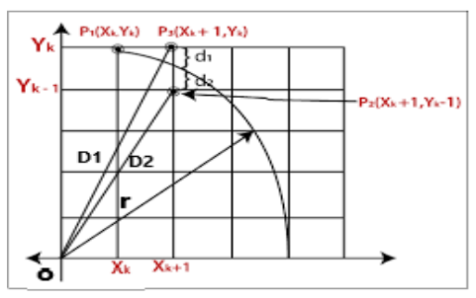
This Algorithm calculates the location of the pixels similarly. Here, we calculate the values only for the first octant and the values for the rest octants can be calculated by extending these values to the other 7 octants, using the eight-way symmetry property of the circle.
Working of Bresenham's Circle Drawing Algorithm
Let us assume we have a point p (x, y) on the boundary of the circle and with r radius satisfying the equation fc (x, y) = 0
As we know the equation of the circle is – fc (x, y) = x 2 + y 2 = r 2 𝑖
𝑓 fc (x, y) = { < 0 The point (x, y) is inside the circle boundary.
= 0 The point (x, y) is on the circle boundary.
>0 The point (x, y) is outside the circle boundary.
The Algorithm works in the following way: Let us consider a point (xk + 1, y) on true circle boundary having a radius 'r'. When the circle passes through two pixels simultaneously then the one to chosen will be decided on the basis of their least distance with the circle.
There can be two positions from which the circle passes:
to the top, say point P3
b. to the bottom, say point P2
The coordinates for point P3 will be (xk + 1, yk).
The coordinates for point P2 will be (xk + 1, yk – 1).
Let, the distance from origin O to point P3= D1
And the distance from origin O to point P2 = D2

Slide 14
According to Pythagoras theorem we can write:
D1= √(xk + 1) 2+ yk 2
D2 = √(xk + 1) 2+ (yk-1) 2
We also assume that,
The distance between point P3 and circle boundary = d1
The distance between point P2 and circle boundary = d2
To simply the algorithm, we have to avoid the squared root calculations:
d1= D1 2 – r 2 = (xk + 1)2 + (yk ) 2 - r 2 [ always +ve because P3 is outside of the circle boundary]
d2=D2 2 – r 2 = (xk + 1 )2 + (yk – 1 )2 - r 2 [ always –ve because P2 is inside of the circle boundary]
Let us introduce the decision parameter Dk which will help in the selection process of the successive points of the circle (Since d1 will always be +ve & d2 will always be -ve). So, we can write Dk as follows:
Dk = d1 + d2
= (xk + 1)2 + (yk ) 2 - r 2 + (xk + 1 )2 + ( yk – 1 )2 - r 2
= 2 (xk + 1 )2+ (yk ) 2 - 2r2 + (yk - 1 )2 ……………………………… (1)
For next decision variable:
Dk+1 = 2 (xk+1 + 1 )2 + (yk+1 ) 2 - 2r2 + (yk+1– 1 )2 ……………………… (2)
If dk < 0, then point P3 is closer to circle boundary, and the final coordinates are- (xk +1, yk+1) = (xk +1, yk)
If dk >= 0, then point P2 is closer to circle boundary, and the final coordinates are- (xk +1, yk+1) = (xk +1, yk -1)
Now, we find the difference between decision parameter equation (2) – equation (1)
dk+1 – dk = 2(xk+1+1)2 + (yk+1) 2– 2r2 + (yk+1–1)2 – 2(xk +1)2 - (yk) 2 + 2r2 - (yk– 1)2
For both points, put xk+1 = xk + 1
dk+1 = dk + 2(xk + 1+1)2 + (yk+1) 2– 2r2 + (yk+1–1)2 – 2(xk +1)2 - (yk) 2 + 2r2 - (yk– 1)2

Slide 15
= dk + 2(xk + 2) 2 + (yk+1) 2– 2r2 + (yk+1–1)2 – 2(xk +1)2 - yk 2 + 2r2 - (yk– 1)2
= dk +2(xk 2 + 2. xk.2 +4) + yk+12 +( yk+1 2 - 2. yk+1 .1+1) - 2(xk 2 + 2. xk.1 +1) - yk 2 - (yk 2 - 2. yk .1+1)
= dk +2xk 2 + 8xk +8 + yk+12 + yk+1 2 - 2yk+1 +1 - 2xk 2 - 4xk -2 - yk 2 - yk 2 +2yk -1
= dk + 4xk +6 + 2yk+12 - 2yk+1 - 2yk 2 +2yk dk+1
= dk +4xk + 2(yk+12– yk 2 ) – 2(yk+1– yk) + 6
Now, we check two conditions for decision parameter
Condition 1: If dk < 0, then yk+1 = yk (We select point P3)
So, we get
dk+1 = dk +4xk + 2(yk 2– yk 2 ) – 2(yk – yk) + 6
= dk +4xk + 6
Condition 2: If dk >= 0, then yk+1 = yk-1 (We select point P2)
So, we get
dk+1 = dk +4xk + 2[(yk-1)2– yk 2 )] – 2(yk-1– yk) + 6
= dk +4xk + 2[(yk 2 - 2.yk .1+1)- yk 2 )] + 2+6
= dk +4xk + 2yk 2 - 4yk + 2 - 2yk 2+8
= dk +4xk - 4yk +10
= dk +4(xk - yk) +10
Now, we calculate initial decision parameter d0, the initial points will be (0, r) [it is assumed that the circle is centered at the origin, then at the first step xo = 0 & y0 = r].
From equation (1):
Dk= 2 (xk + 1 )2+ (yk ) 2 - 2r2 + (yk - 1 )2
So, D0= 2 (xo + 1 )2+ (y0 ) 2 - 2r2 + (y0 - 1 )2
D0 = 2 (0 + 1 )2+ (r ) 2 - 2r2 + (r - 1 )2
D0 = 2 + r 2 - 2r2 +r 2 – 2r + 1
D0 = 3- 2r

Slide 16
Advantages of Bresenham's Circle Drawing Algorithm
The Bresenhem’s circle drawing algorithm uses integer arithmetic which makes the implementation less complex.
Due to its integer arithmetic, it is less time-consuming.
This algorithm is more accurate than any other circle drawing algorithm as it avoids the use of round off function.
Disadvantages of Bresenham's Circle Drawing Algorithm
This algorithm does not produce smooth results due to its integer arithmetic as it fails to diminish the zigzags completely.
The Bresenhem’s circle drawing algorithm is not accurate in the case of drawing of complex graphical images.

Slide 17
Step 1: Start.
Step 2: Declare x, y, r, h, k and d as variables, where (h, k) are coordinates of the center.
Step 3: Calculate the decision parameter as follows: D = 3 - 2r
Step 4: Initialize x = 0, y = r
Step 5: If x >= y Stop.
Step 6: Plot eight points by using concepts of eight-way symmetry. The center is at (h, k). Current active pixel is (x, y).
putpixel (x+h, y+k)
putpixel (y+h, x+k)
putpixel (-y+h, x+k)
putpixel (-x+h, y+k)
putpixel (-x+h, -y+k)
putpixel (-y+h, -x+k)
putpixel (y+h, -x+k)
putpixel (x+h, -y-k)
Step 7: If D < 0
then D = D + 4x + 6
x = x + 1
y = y
If D ≥ 0
then D = D+ 4 (x - y) + 10
x = x + 1
y = y – 1
Step 8: Go to step 5.

Slide 18
Example-01: The radius of a circle is 7, and center point coordinates are (0, 0). Apply bresenham’s circle drawing algorithm to plot all points of the circle.
Solution: Given radius r= 7 And initial center coordinates (h, k): (0, 0)
Initialize x = 0, and y = r=7 Calculate D= 3 – 2r = 3 – 2.7= -11
Step | X | Y | (x,y) | Plot (x+h, y+k) = (x + 0, y +0) | Previous Decision parameter(D) | D<0 : D = D + 4x + 6 [ x = x+1, y=y ] D>= 0 : D = D + 4(x – y) + 10 [ x = x+1, y=y-1 ]
1 | 0 | 7 | (0, 7) | = (0, 7) | - 11 | D = D + 4x + 6 = -11 + 4*0 + 6 = -5 x = x+1 = 0+1 = 1 y = 7 new points = (1, 7)
2 | 1 | 7 | (1, 7) | = (1, 7) | -5 | D = D + 4x + 6 = -5 + 4*1 + 6 = 5 x = x + 1 = 1+1 =2 y = 7 new points = (2, 7)
3 | 2 | 7 | (2, 7) | = (2, 7) | 5 | D = D + 4(x – y) + 10 =5 + 4(2-7) + 10 = -5 x = x+1 = 2+1 = 3 Y = y-1 = 7-1 = 6 new points = (3, 6)
4 | 3 | 6 | (3, 6) | = (3, 6) | -5 | D = D + 4x + 6 = -5 + 4*3 + 6 = 13 x = x + 1 = 3+1 =4 y = 6 new points = (4, 6)
5 | 4 | 6 | (4, 6) | = (4, 6) | 13 | D = D + 4(x – y) + 10 =13 + 4(4-6) + 10 = 15 x = x+1 = 4+1 = 5 Y = y-1 = 6-1 = 5 new points = (5, 5)
6 | 5 | 5 | (5, 5) | = (5, 5) | Since x>=y i.e., 5=5, so stops here.
These are all the points of octant -1.

Slide 19
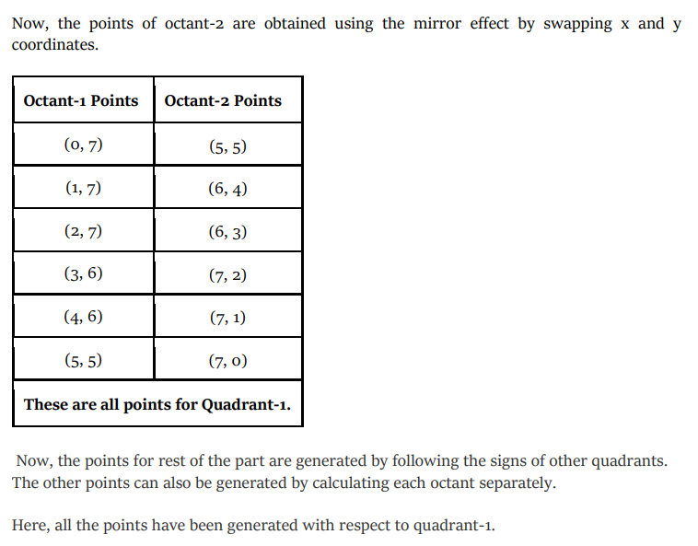

Slide 20
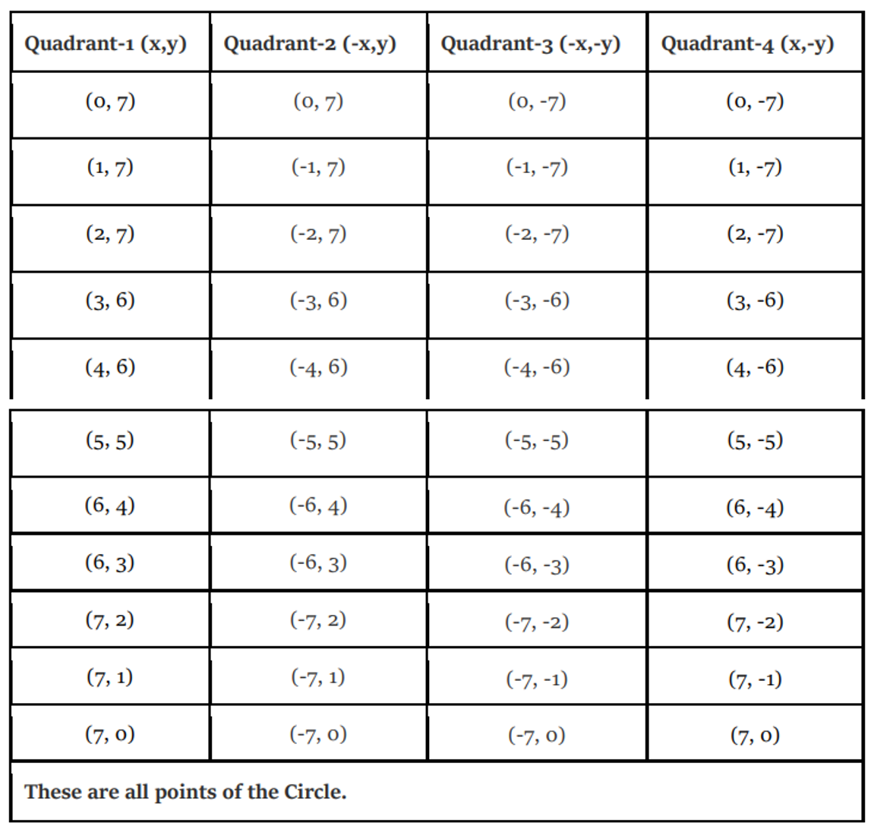

Slide 21
Example-02: The radius of a circle is 8, and center point coordinates are (0, 0). Apply bresenham’s circle drawing algorithm to plot all points of the circle.
Solution: Given radius r= 8 And initial center coordinates (h, k): (0, 0)
Initialize x = 0, and y = r=8 Calculate D= 3 – 2r = 3 – 2.8= -13
Step | X | Y | (x,y) | Plot (x+h, y+k) = (x + 0, y +0) | Previous Decision parameter(D) | D<0 : D = D + 4x + 6 [ x = x+1, y=y ] D>= 0 : D = D + 4(x – y) + 10 [ x = x+1, y=y-1 ]
1 | 0 | 8 | (0, 8) | (0, 8) | -13 | D = D + 4x + 6 = x = x+1 = y = new points = ()
2
6 | 5 | 5 | (5, 5) | = (5, 5) | Since x>=y i.e., 5=5, so stops here.
These are all the points of octant -1.

Slide 22
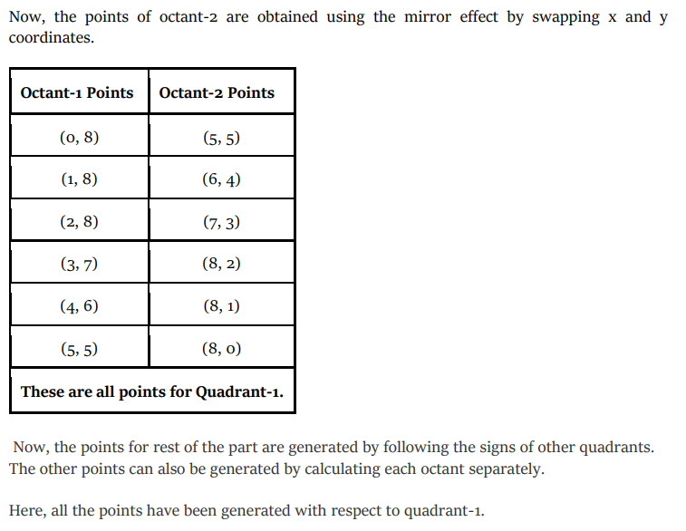

Slide 23
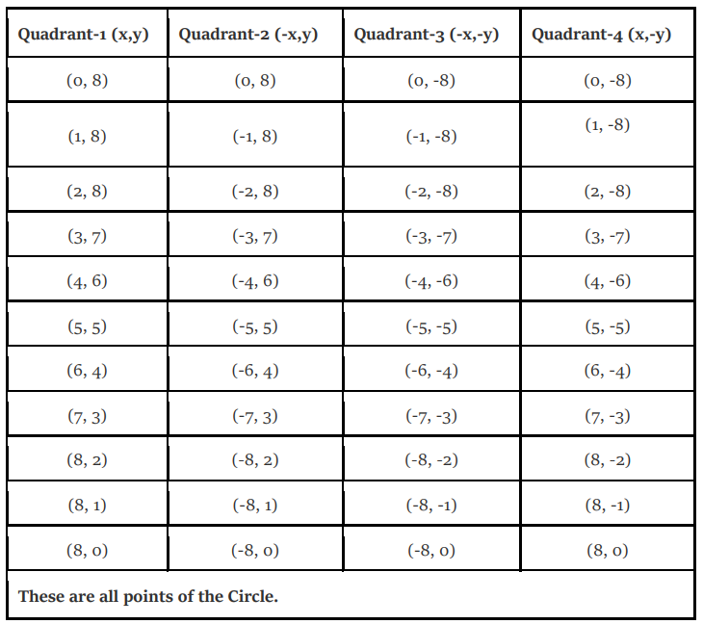

Slide 24
Example-03: Plot all points of circle using Bresenham Algorithm. When radius of circle is 10 units. The circle has center (0, 0).
Solution: Given radius r= 10 And initial center coordinates (h, k): (0, 0)
Initialize x = 0, and y = r=10 Calculate D= 3 – 2r = 3 – 2.10= -17
Step | X | Y | (x,y) | Plot (x+h, y+k) = (x + 0, y +0) | Previous Decision parameter(D) | D<0 : D = D + 4x + 6 [ x = x+1, y=y ] D>= 0 : D = D + 4(x – y) + 10 [ x = x+1, y=y-1 ]
1 | 0 | 8 | (0, 8) | (0, 8) | -13 | D = D + 4x + 6 = x = x+1 = y = new points = ()
2
6 | 5 | 5 | (5, 5) | = (5, 5) | Since x>=y i.e., 5=5, so stops here.
These are all the points of octant -1.

Slide 25
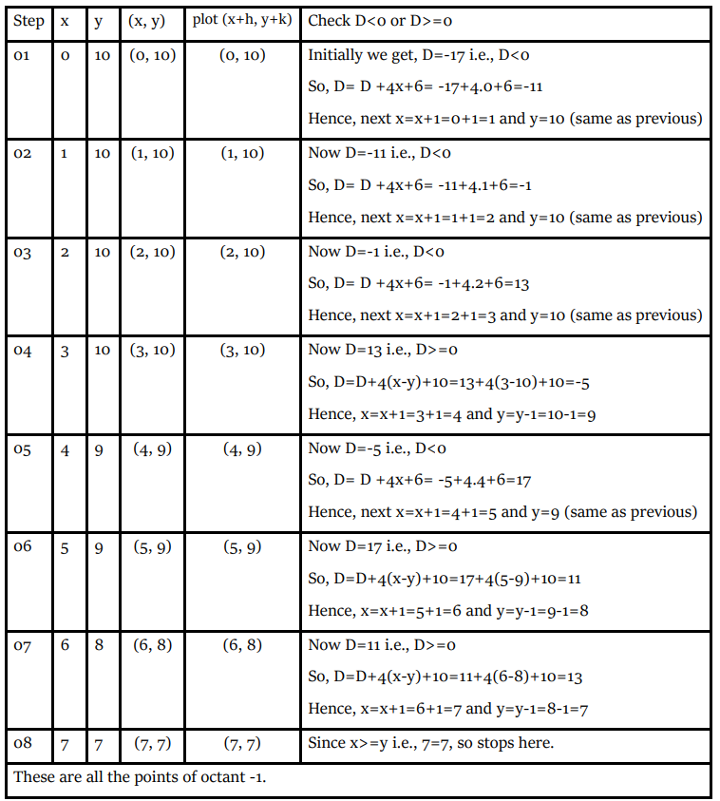
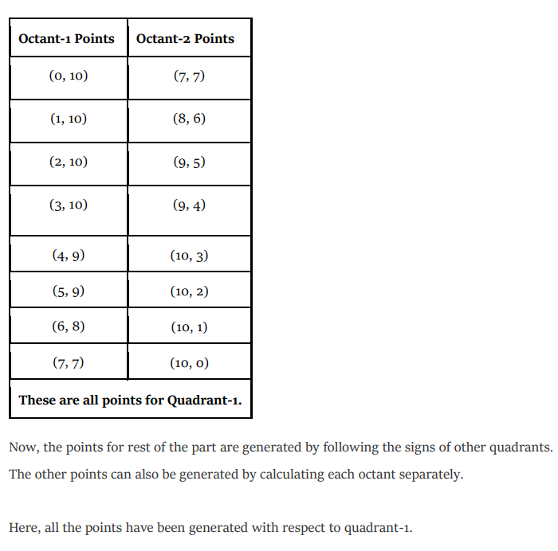

Slide 26
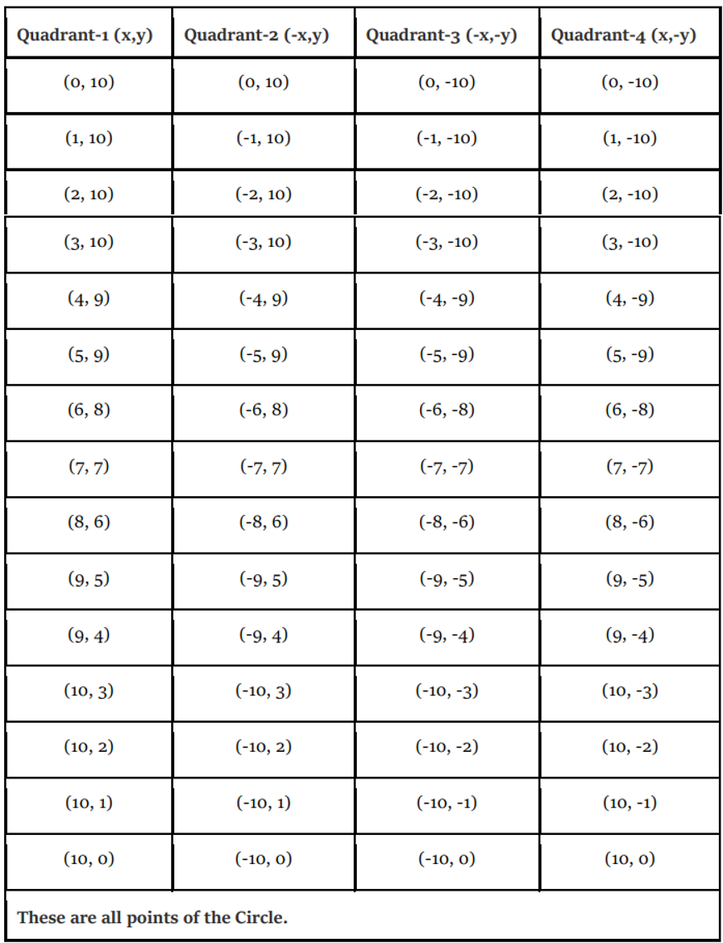

Slide 27
Example-04: Plot all points of circle using Bresenham Algorithm. When radius of circle is 10 units. The circle has center (50, 50).
Solution: Given radius r= 10 And initial center coordinates (h, k): (50, 50)
Initialize x = 0, and y = r=10 Calculate D= 3 – 2r = 3 – 2.10= -17
Step | X | Y | (x,y) | Plot (x+h, y+k) = (x + 50, y +50) | Previous Decision parameter(D) | D<0 : D = D + 4x + 6 [ x = x+1, y=y ] D>= 0 : D = D + 4(x – y) + 10 [ x = x+1, y=y-1 ]
1 | 0 | 8 | (0, 8) | (0, 8) | -13 | D = D + 4x + 6 = x = x+1 = y = new points = ()
2
6 | 5 | 5 | (5, 5) | = (5, 5) | Since x>=y i.e., 5=5, so stops here.
These are all the points of octant -1.

Slide 28
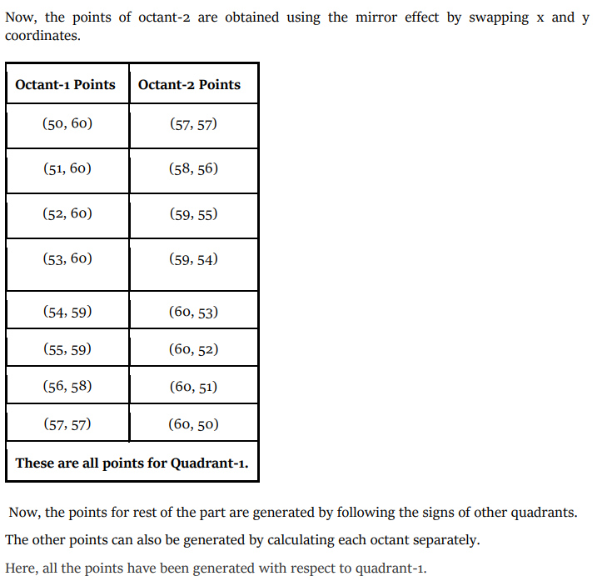

Slide 29
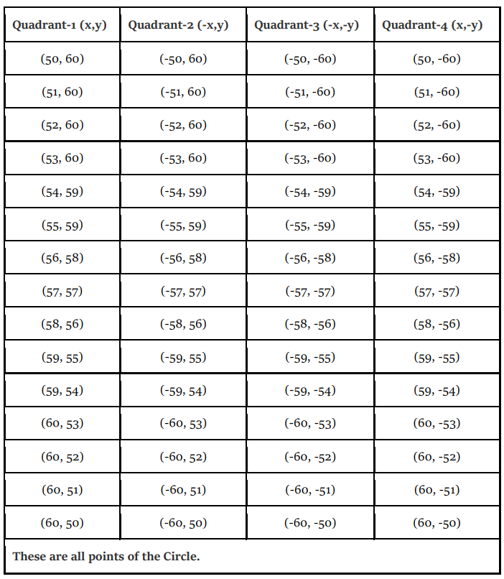

Slide 30
Example-05: Given the center point coordinates (10, 10) and radius as 10, generate all the points to form a circle using Bresenham Algorithm.
Solution: Given radius r= 10 And initial center coordinates (h, k): (10, 10)
Initialize x = 0, and y = r=10 Calculate D= 3 – 2r = 3 – 2.10= -17
Step | X | Y | (x,y) | Plot (x+h, y+k) = (x + 10, y +10) | Previous Decision parameter(D) | D<0 : D = D + 4x + 6 [ x = x+1, y=y ] D>= 0 : D = D + 4(x – y) + 10 [ x = x+1, y=y-1 ]
1 | 0 | 8 | (0, 8) | (0, 8) | -13 | D = D + 4x + 6 = x = x+1 = y = new points = ()
2
6 | 5 | 5 | (5, 5) | = (5, 5) | Since x>=y i.e., 5=5, so stops here.
These are all the points of octant -1.

Slide 31
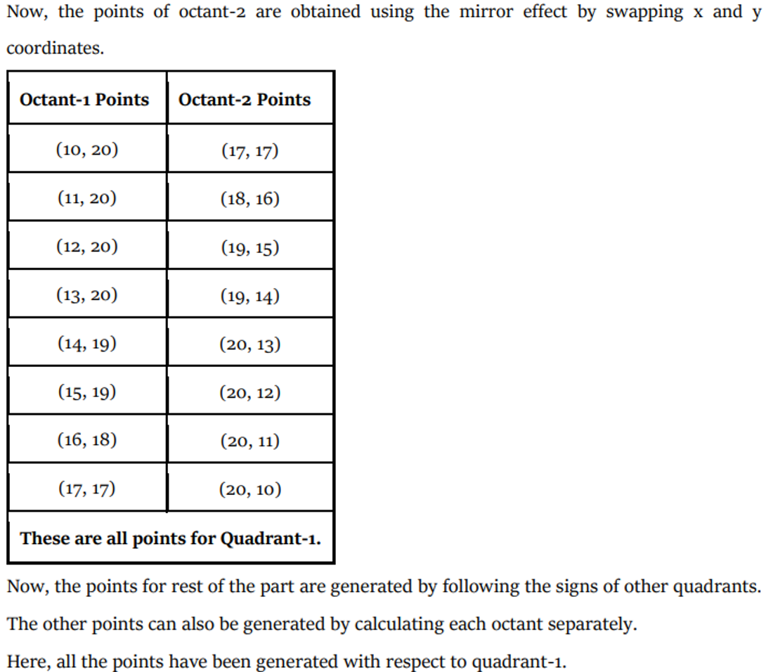

Slide 32
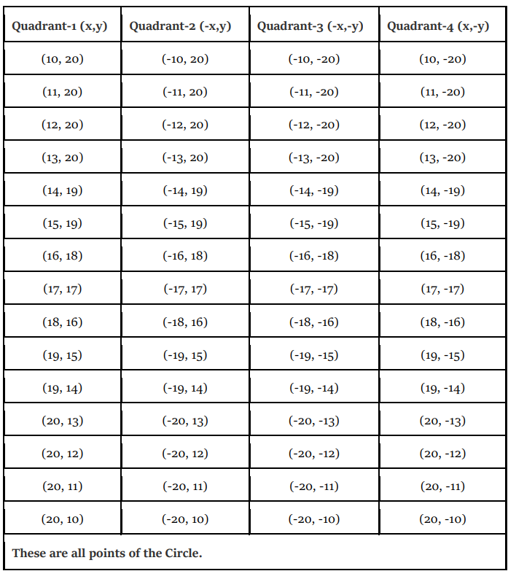

Slide 33
Assignment (Solve these problems using Bresenham’s Circle Algorithm)
Problem-01: The radius of a circle is 7, and center point coordinates are (0, 0). Apply bresenham’s circle drawing algorithm to plot all points of the circle.
Problem-02: The radius of a circle is 8, and center point coordinates are (0, 0). Apply bresenham’s circle drawing algorithm to plot all points of the circle.
Problem-03: Plot all points of circle using Bresenham Algorithm. When radius of circle is 10 units. The circle has center (0, 0).
Problem-04: Plot all points of circle using Bresenham Algorithm. When radius of circle is 10 units. The circle has center (50, 50).
Problem-05: Given the center point coordinates (10, 10) and radius as 10, generate all the points to form a circle using Bresenham Algorithm.

